Slide 1
CUSTOM PC BUILDER
MINI PROJECT

Slide 2
TEAM MEMBERS
MEMBER 1 : Shivam Singh Bisht
1802710136 (RollNo.)
MEMBER 2 : Shivam Sahni
1802710134 (RollNo.)
MEMBER 3 : Shubham Gupta
1802710146 (RollNo.)

Slide 3
TECH USED
Software : Python-3 and above, CMD(Debugging and running)
Packages : pickle, sys
Hardware : -Nil-
PC Requirements : 2gb RAM (min.)

Slide 4
ABOUT
Helps user to build a custom PC.
Select rams, processors and motherboards for your CPU.
Shows the total price before user checkouts.
A backend without using any database.
Instead binary files are used.
pickle is used to store the variables in the files.

Slide 5
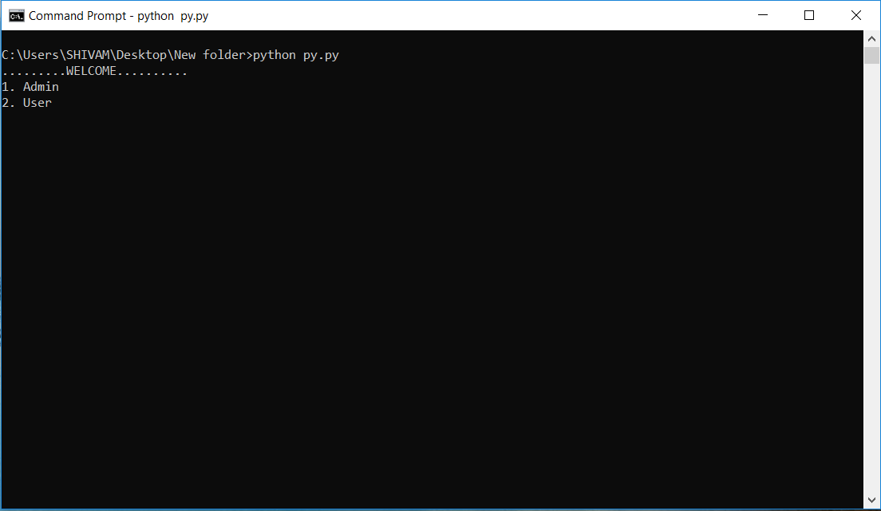
COMPONENTS
Admin login.
User Login.

Slide 6
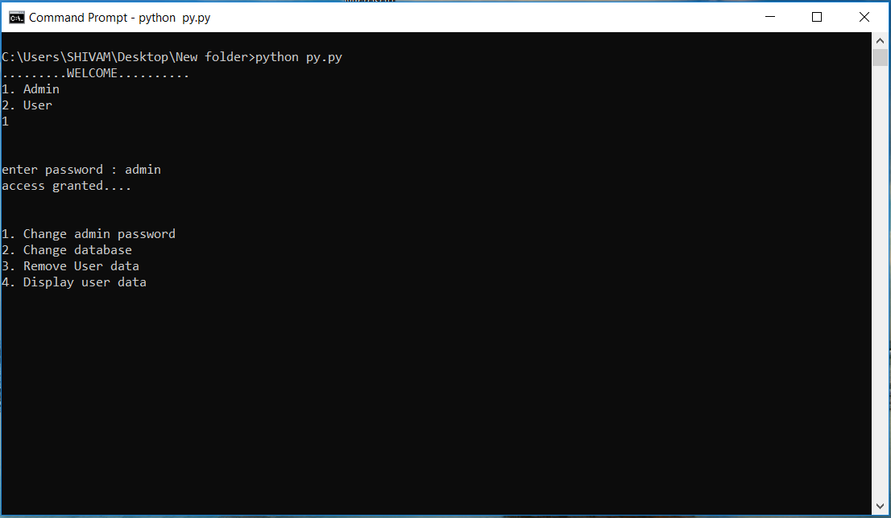
ADMIN
Asks for admin password.
Shows the actions what an admin
can performs.

Slide 7
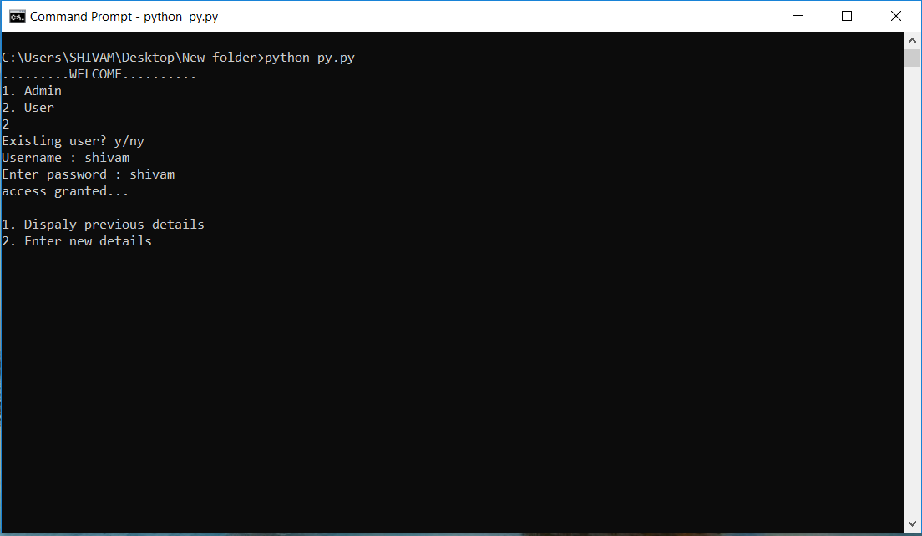
USER
Asks for existing user or not.
Enter username and password to
get in.

Slide 8
PROS

Slide 9
CONS

Slide 10
THANK U
COMING FROM
SHIVAM BISHT SHIVAM SAHNI SHUBHAM GUPTA

